Slide 1
The Early Political Bengal: Etymology of Bengal, Gangaridai empire, The Pala dynasty, and Sena dynasty.
By
Chowdhury Mujaddid Ahmed

Slide 2
Etymology of Bengal
BENGAL The name "Bengal" (or Bangla) comes from Vanga or Banga, the name of the ancient deltaic kingdom.
Bengal is mentioned in the Purāṇas and other ancient Sanskrit literature and was known to the Romans, mentioned in The Periplus of the Erythean Sea (first-century a.d.) and in Ptolemy's Geography the following century.
According to the Buddhist text Anguttara Nikaya, Magadha was one of sixteen major states (mahajanapadas, "great tribal regions") in North India between about 770 and 450 b.c.;
Anga, in the northwest of Bengal, was the easternmost of these.
-Source: Encyclopidia.com

Slide 3
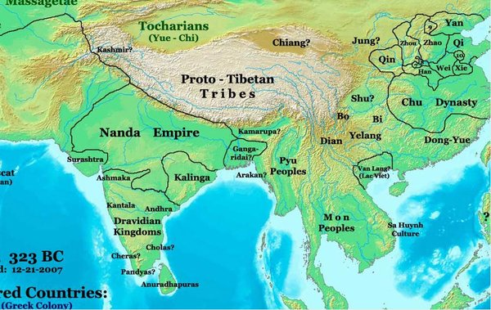
Gangaridai empire
Believed to have been established around 300 BCE, the state of Gangaridai and its capital city of Gange, was located in the historical and geographical region referred to as Bengal – an area including present-day Bangladesh and India’s West Bengal State.
The ruins of the city of Gange have not yet been discovered.
The earliest reference to Gangaridai is found in the written works of the Greek ethnographer Megasthenes (350-290 BCE).

Slide 4
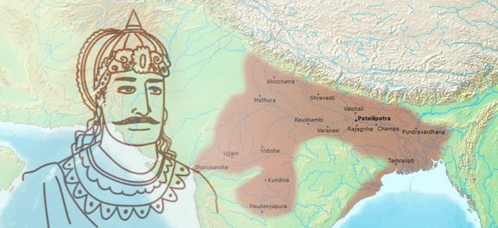
Nanda dynasty
Dhana Nanda, the last ruler of the Nanda dynasty, was king of the Gangaridai region at the time of the invasion by Alexander the Great.
The Nanda dynasty was an amalgamation of the Prasii and Gangaridai Empires. Dhana Nanda was later dethroned by Chandragupta Maurya.

Slide 5
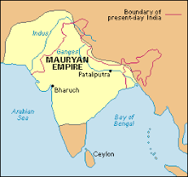
Maurya dynasty
The Mauryan Empire, which formed around 321 B.C.E. and ended in 185 B.C.E., was the first pan-Indian empire,
an empire that covered most of the Indian region.
It spanned across central and northern India as well as over parts of modern-day Iran.

Slide 6
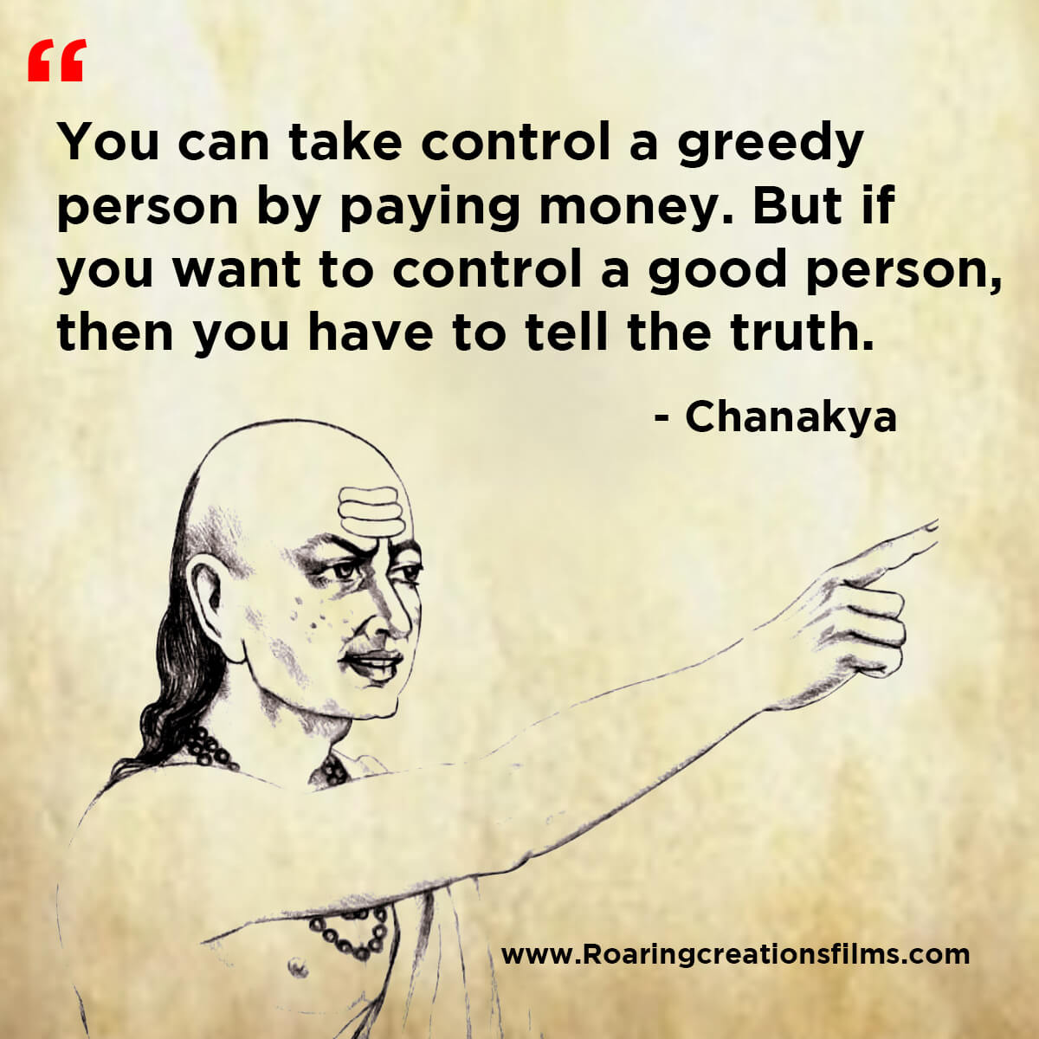
Maurya dynasty (Continued)
Chandragupta’s chief minister Kautilya, sometimes called Chanakya, advised Chandragupta and contributed to the empire’s legacy.
political strategist, Kautilya is also known for writing the Arthashastra, a treatise about leadership and government.
The Arthashastra describes how a state should organize its economy and maintain power.

Slide 7
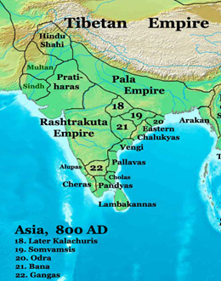
The Pala dynasty
Pala dynasty, the ruling dynasty in Bihar and Bengal, India, from the 8th to the 12th century.
Its founder, Gopala, was a local chieftain who rose to power in the mid-8th century during a period of anarchy.

Slide 8
The Pala dynasty
Dharmapala (reigned c. 770–810)
Gopala
Devapala (reigned c. 810–850)
Ramapala (reigned c. 1077–1120)

Slide 9
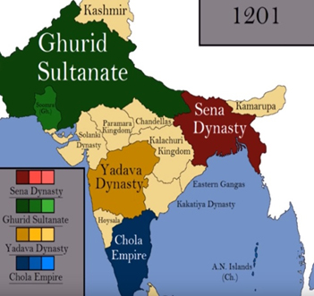
The Sen dynasty
Sena dynasty, an Indian dynasty ruling in Bengal in the 11th and 12th centuries CE.
Their ancestors came from the south and established themselves as chieftains in southwestern Bengal early in the 11th century.
Hemantasena, the founder of the dynasty, was originally a tributary of the Pala dynasty.

Slide 10
The Sen dynasty
Hemantasena
Vijayasena (reigned c. 1095–1158)
Vallalasena
Lakshmanasena (reigned c. 1178– c. 1205)

Slide 11
Thank you
End
of
Lecture 7

